Slide 1
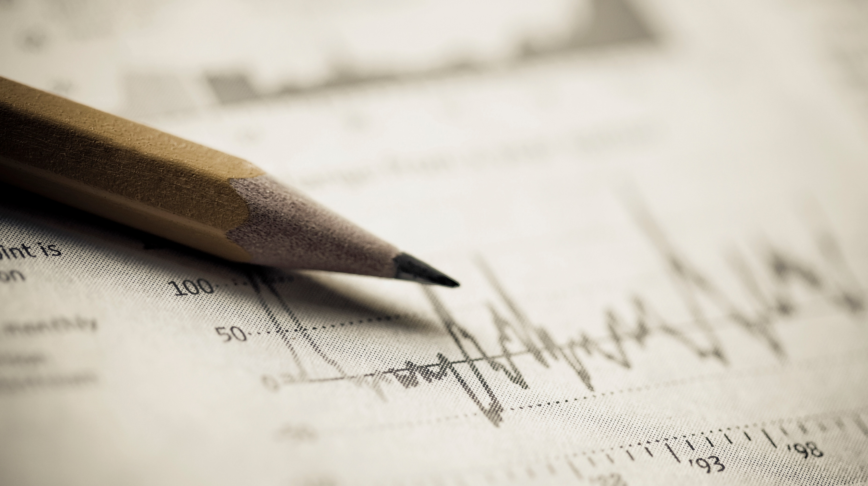
Dhaval Patel
Hemanand Vadivel
Telangana Government Tourism Department

Slide 2
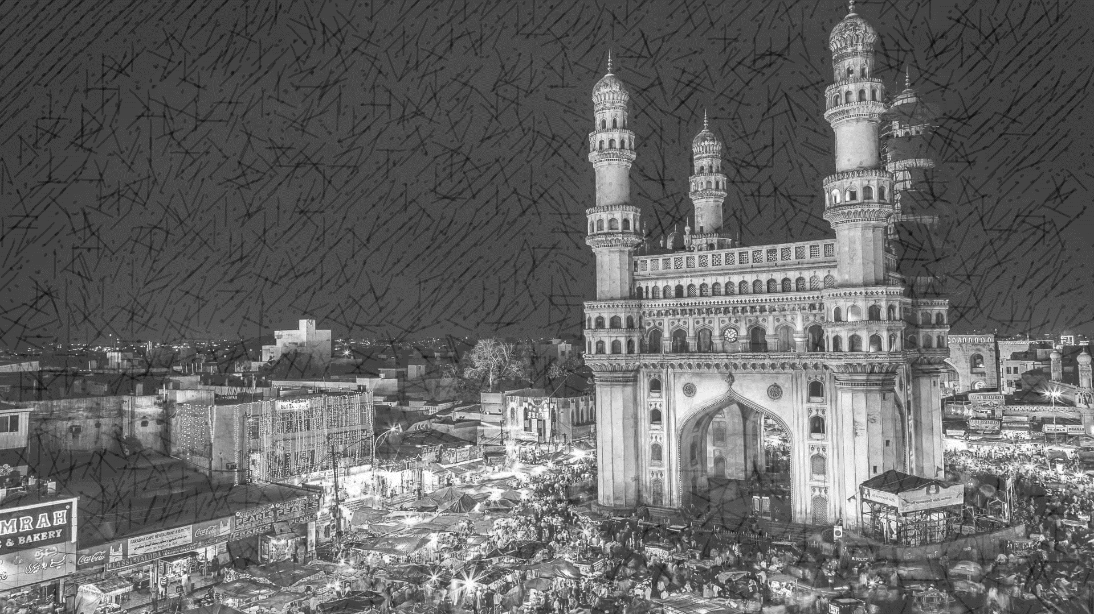
today's agenda
Preliminary Questions
1. Top 10 Districts based on highest domestics visitors
2. List down the Top and Bottom 3 Districts based on CAGR
3. Peak and low season for Hyderabad
4. List down the Top and Bottom 3 Districts with high domestic to foreign ratio
Secondary Questions
1. Tourist footfall ratio
2. Growth rate for 2025 to domestic and foreign

Slide 3
Recommendations
1. District with highest potential
2. Event to boost tourism
3. Can Hyderabad emulate the Dubai model

Slide 4
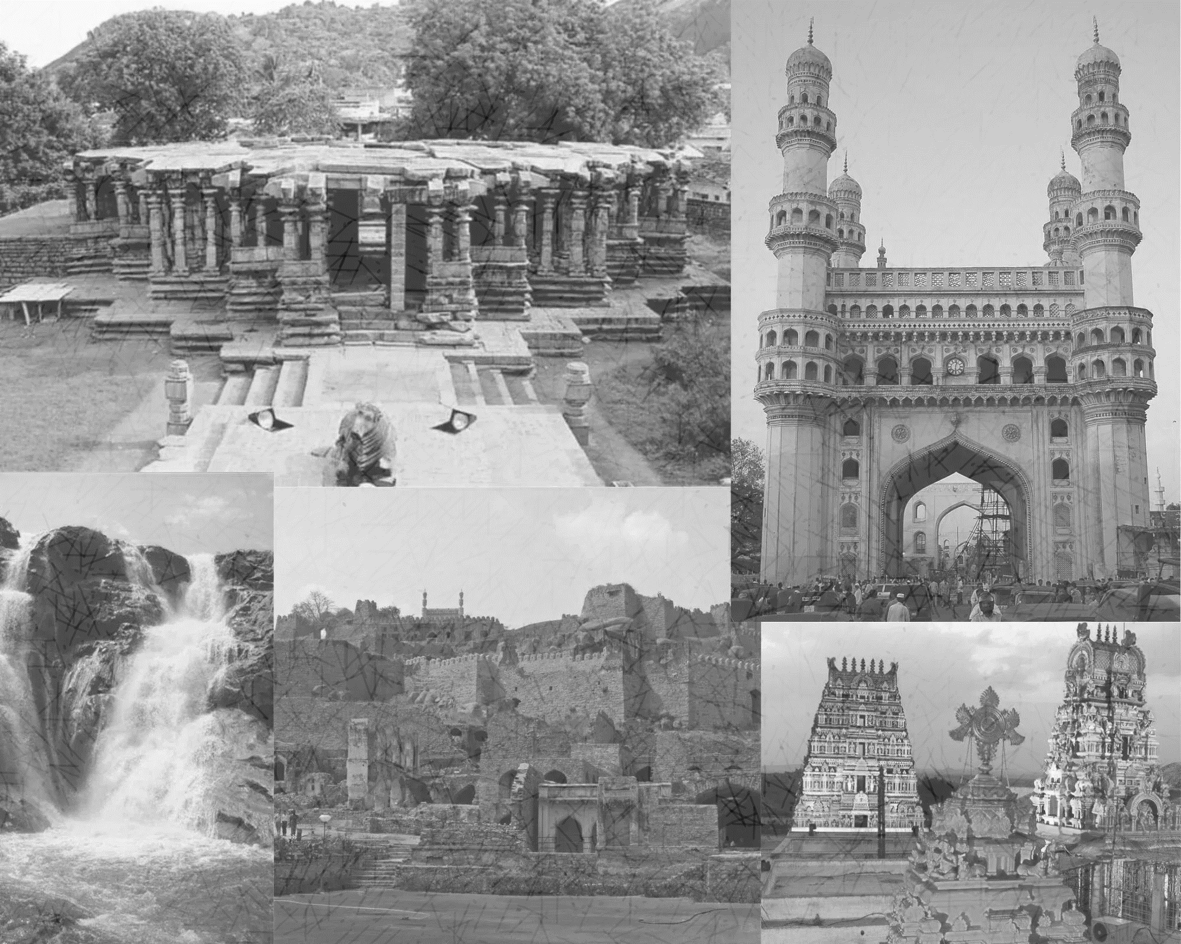
Summary of Telangana
Telangana is a state located in the southern part of India. It was officially formed as a separate state on June 2, 2014, after being carved out from the larger state of Andhra Pradesh. The capital city of Telangana is Hyderabad, which also serves as a major technological and economic hub. It consist of 33 districts
The region has a rich historical and cultural heritage, with influences from various dynasties and empires, including the Kakatiyas, Chalukyas, Mughals, and Nizams. The state is known for its distinct culture, language (Telugu), and traditions.
Telangana has a diverse landscape, ranging from fertile plains to semi-arid regions. The economy of the state is multifaceted, with agriculture, industry, and services sectors playing significant roles. Hyderabad, often referred to as "Cyberabad," is a major IT and business hub, hosting numerous global tech companies, research institutions, and universities. The growth of the information technology sector has contributed to the state's rapid urbanization and economic development.
Overall, Telangana is a dynamic state that blends its rich history with modern advancements, making it an important contributor to India's cultural, economic, and technological landscape.

Slide 5
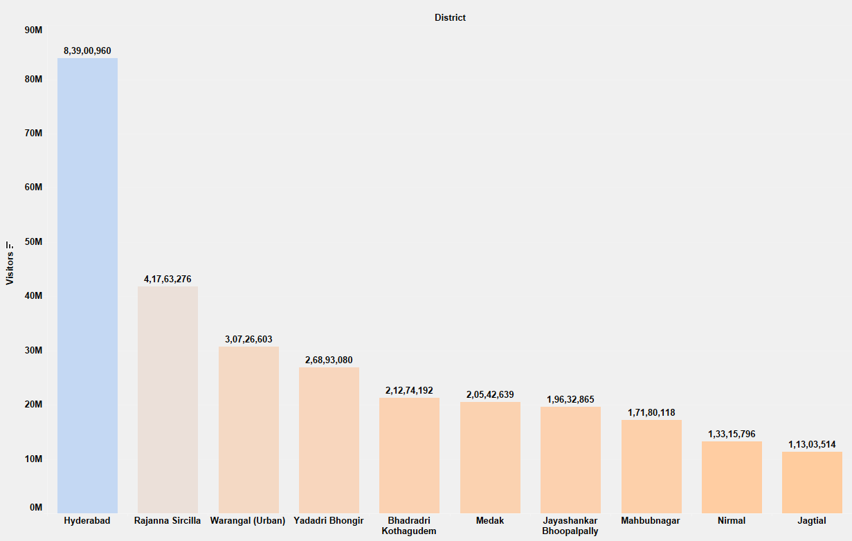
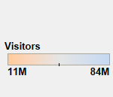
Preliminary Questions
1. Top 10 Districts based on highest domestics visitors
Golconda Fort, Char Minar, ShriJagannath Temple, Birla Mandir, Ramoji Film City, Hussain Sagar Lake, Mecca Masjid
Golconda was the principal capital of the Qutub Shahi kings. The inner fort contains ruins of palaces, which rises about 130 meters high. Golconda fort is undoubtedly one of most magnificent fortress complexes in India.

Slide 6
2. List down the Top and Bottom 3 Districts based on CAGR
Top 3 Districts based on CAGR
Bottom 3 Districts based on CAGR
Mancherial
Warangal (Urban)
142.50
-48.63
Bhadradri Kothagudem
Nalgonda
118.50
-60.61
Warangal (Rural)
Karimnagar
106.60
-69.67

Slide 7
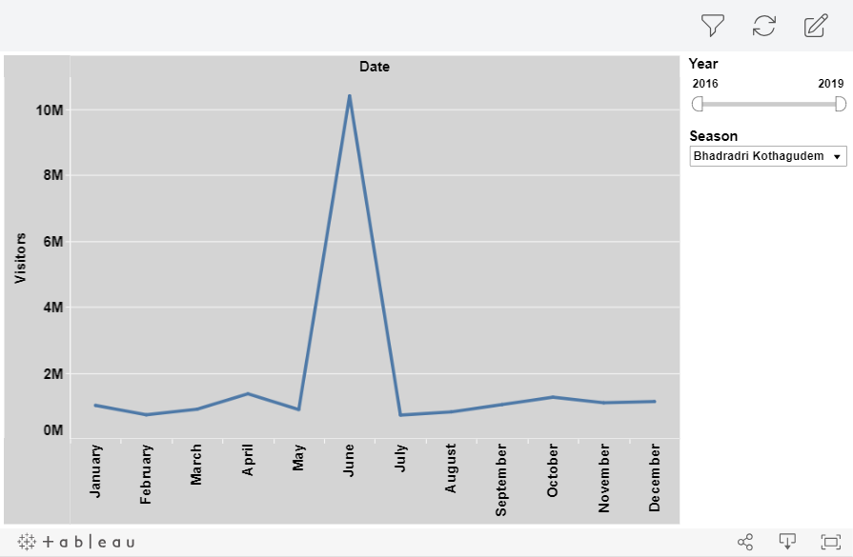
3. Peak and low season for Hyderabad
Bonalu starts with the Aahsda month according
To the Hindu calendar and the goddess Mahankali
is worshiped The festival is also called Mahankali
Bonalu 2023. The month-long Bonalu festival
celebrations in Telangana start from
22 June 2023 to 16 July 2023

Slide 8
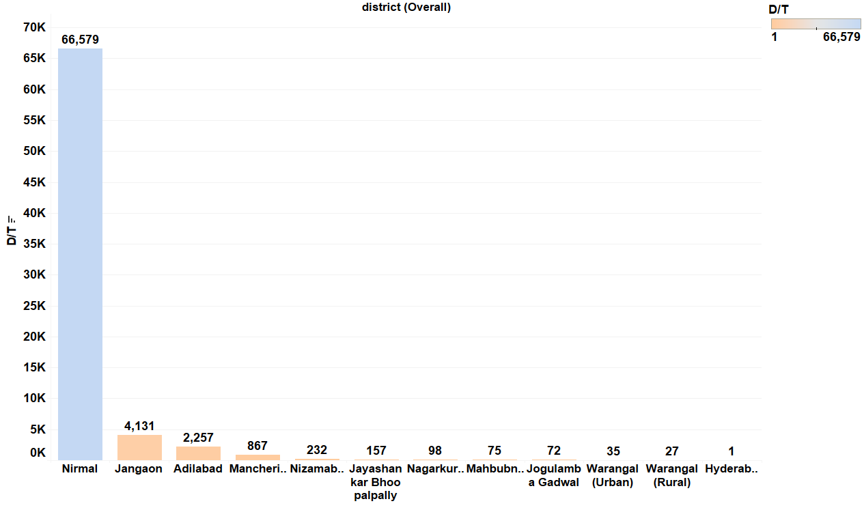
4. List down the Top and Bottom 3 Districts with high domestic to foreign ratio
Nirmal has highest foot fall ration
Compare to other districts in Telangana
District | Ratio
Nirmal | 66578.98
Jangaon | 4131.40
Adilabad | 2256.82
Warangal (Urban) | 34.83
Warangal (Rural) | 26.77
Hyderabad | 0.80

Slide 9
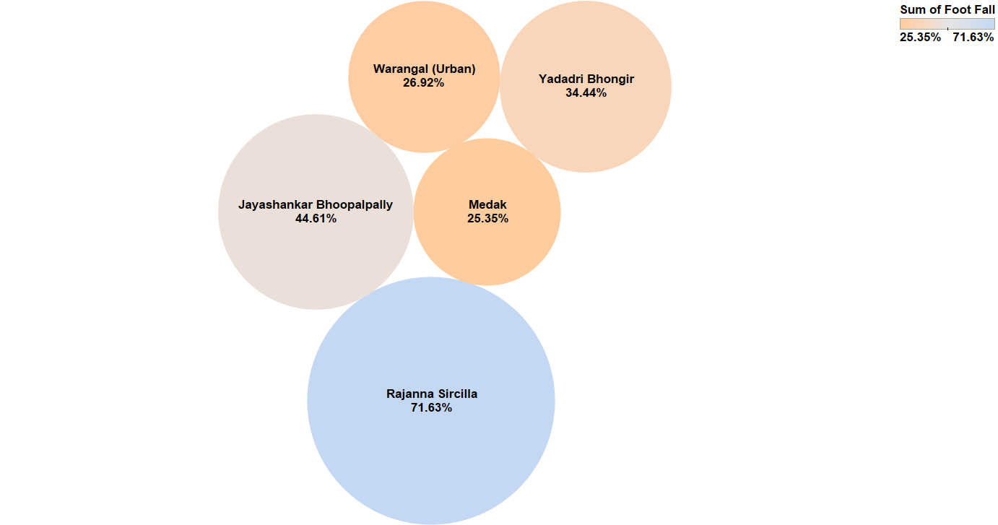
Secondary Questions
1. Tourist footfall ratio
Top 5 District
Vemulawada: The temple is dedicated to Lord Shiva and attracts devotees from the region.
Kondagattu Anjaneya Swamy Temple: Located near Vemulawada, this temple is dedicated to Lord Hanuman. It's known for its unique architecture and religious importance.
Chalukya Temples at Basarlapalli: These ancient temples showcase architectural and historical significance.

Slide 10
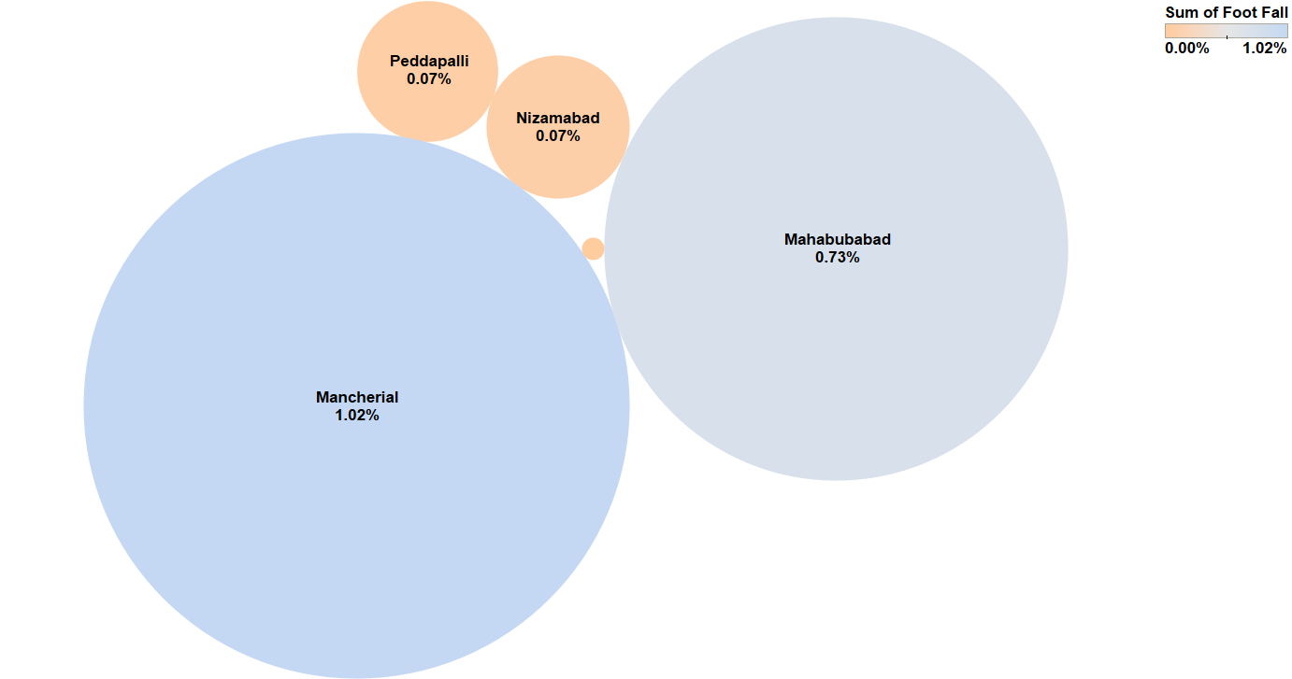
Bottom 5 District
Lack of Awareness: Lack of awareness among travelers can significantly impact tourist footfall.
Accessibility: Poor transportation connections, such as limited flights, trains, or road networks, can discourage tourists from visiting the area.
District | Foot Fall
Kamareddy | 0.00%
Peddapalli | 0.07%
Nizamabad | 0.73%
Mahabubabad | 1.02%
Mancherial | 1.08%

Slide 11
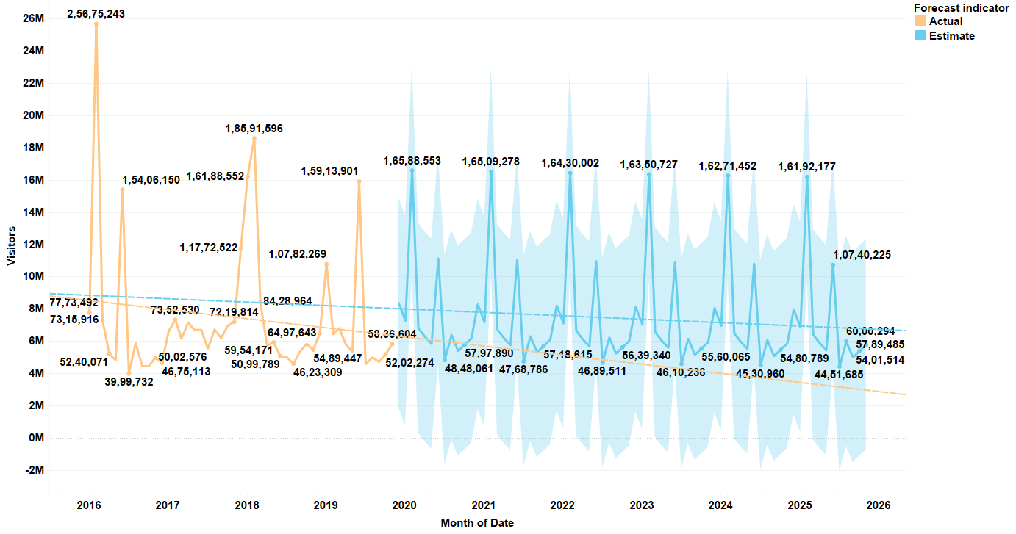
2. Growth rate for 2025
Total Domestic visitors visits Telangana
in 2025 are 531M
Domestic

Slide 12
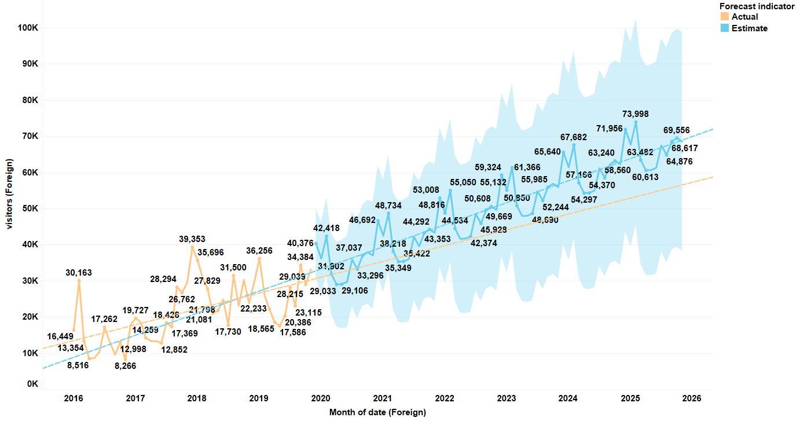
Total Foreign visitors visits Telangana
in 2025 are 3M
Foreign

Slide 13
Charminar
Recommendations
Salar Jung Museum
1. District with highest potential
Hyderabad
Golconda Fort
Large Area
Parking
Lack of Facilities
Physical Effort
Qutub Shahi Tombs
Ramoji Film City

Slide 14
2. Event to boost tourism
Corporates are conducting more events in monthly basis which attract youngsters in that time government government should publish or communicate through social media post about the tourist spot and the highlights of the area
The person who wins the event want to get some discount in there tickets. so that he/she may explore the place which will helpful for the future visiting with there family or friends
Corporates

Slide 15
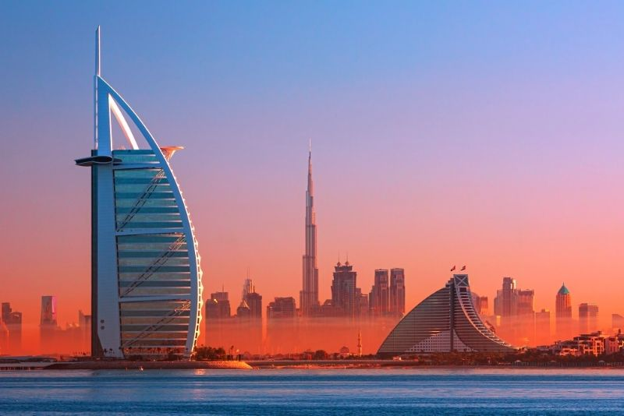
3. Can Hyderabad emulate the Dubai model
Hyderabad
VS
Dubai
palm jumeirah
Burj Khalifa
Atlantis Aquaventure

